Slide 1
Week 5/6 Updates: SolidWorks DFM Plug-In
Ruoyu Song
Dr. Cassandra Telenko
Aniruddh Marellapudi

Slide 2
Updates from Week 5/6
Plug-in changes default export setting in Solidworks
Part is exported with user-specified coordinate axes
Limit raw material list to simple materials
Added info buttons so users can learn the function of each section of plug-in
Save all tolerances and notes as custom properties in Solidworks
Machinist can open part and read back user-specified values
Continued building SculptPrint feedback pathway

Slide 3
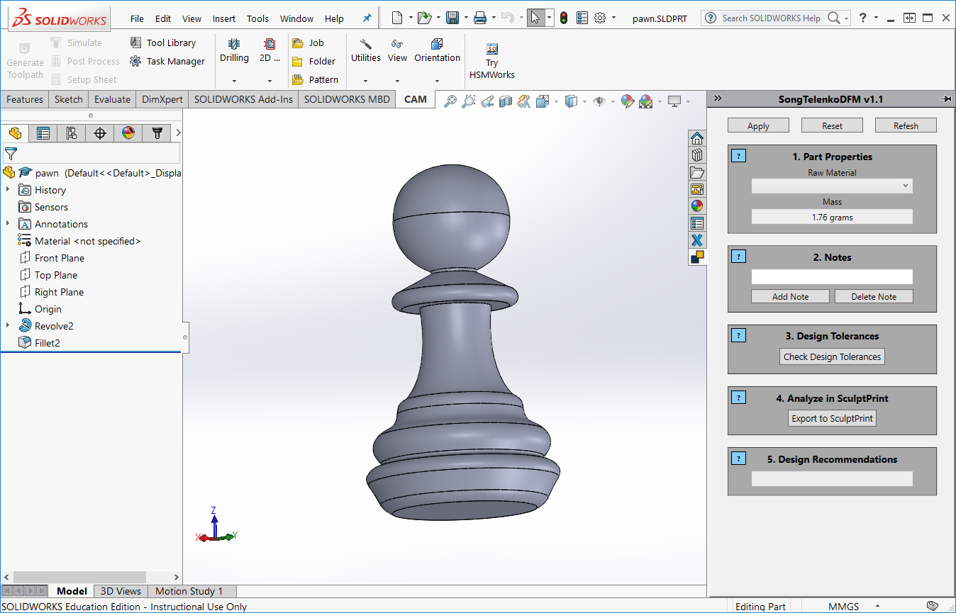

Slide 4
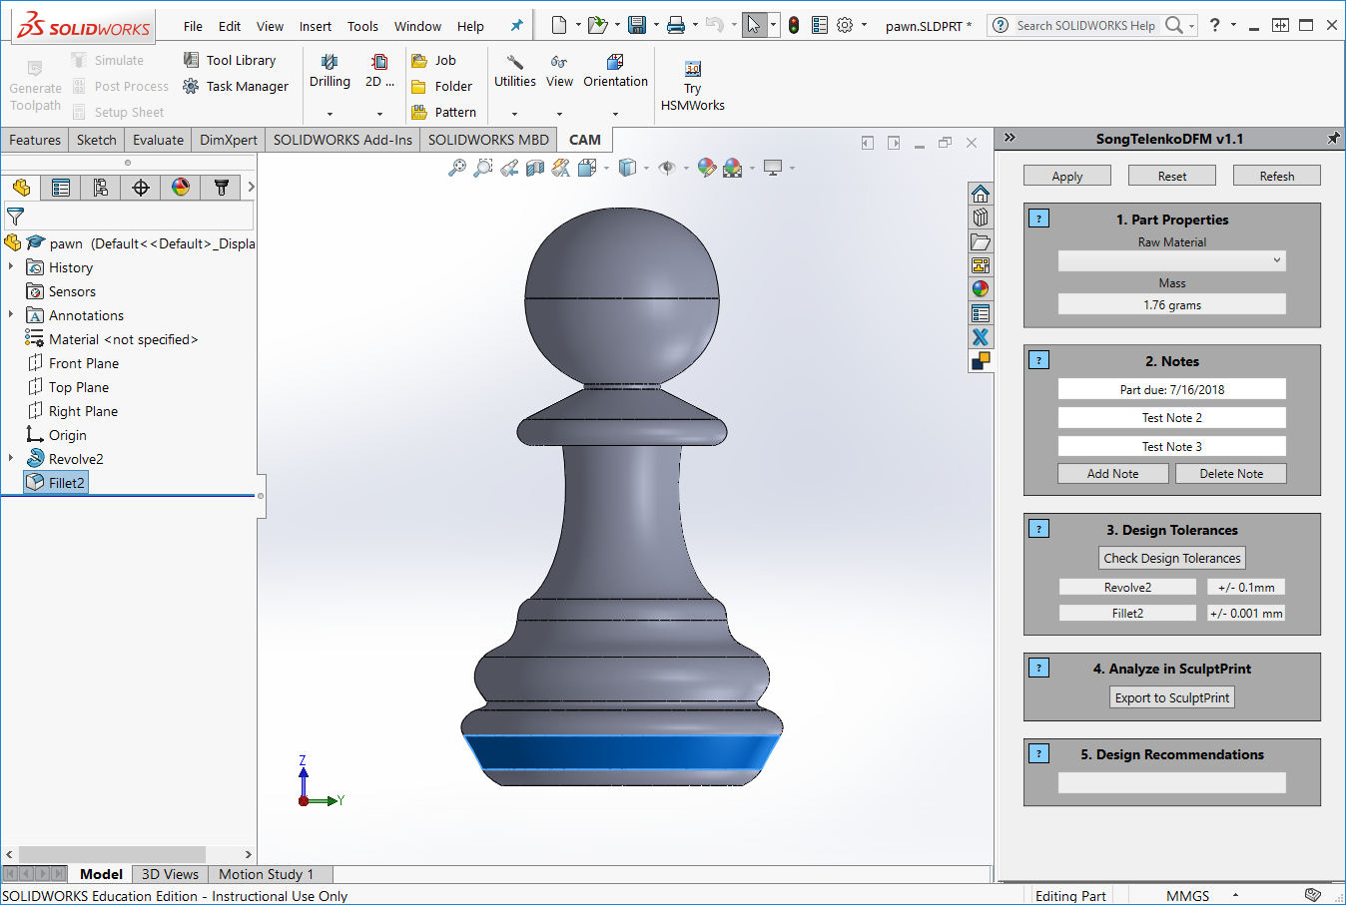

Slide 5
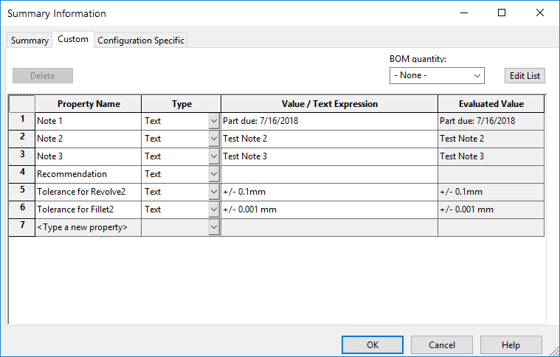

Slide 6
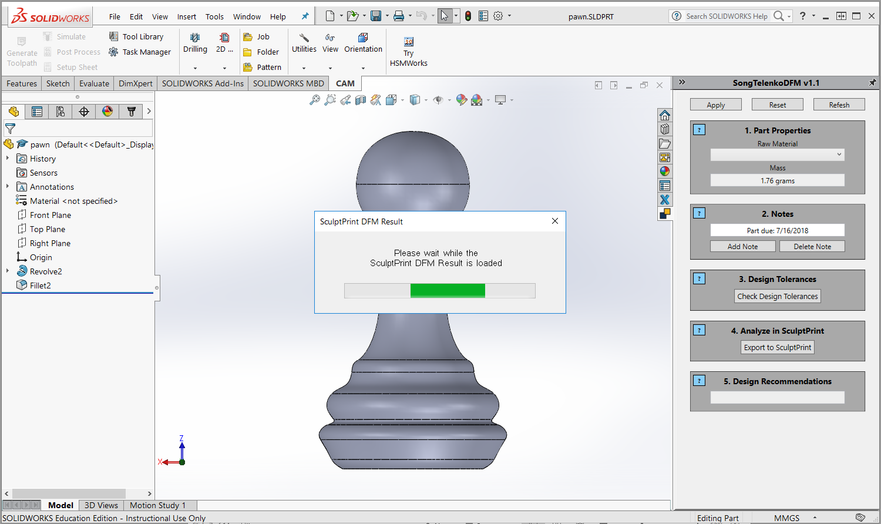

Slide 7
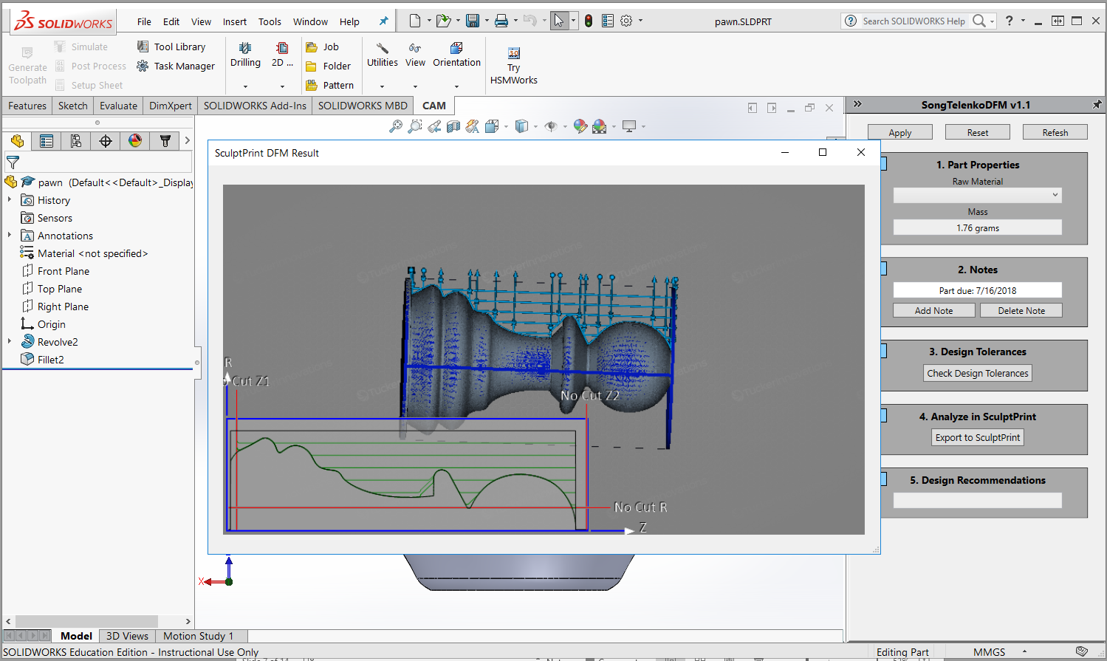

Slide 8
Next Steps
Continue work on SculptPrint interface (need direction)
Can we log into the Virtual Machine from the conference?
If not, we need another install of SculptPrint
Which computer will be running the test plug-in?
Current SculptPrint automation sequence still takes >30 seconds
If this is too long to wait, how can we speed this up?
M60 VM has SculptPrint 3 → Can we update this to SculptPrint 4?
If so, we can import python scripts more easily
Keep documenting everything + make installation report
Make guide for tutorial part

Slide 9
Project Decisions
Need a proper name and description to display in SolidWorks
Need to determine ideal instructions for message-box prompts
Need to choose message prompts when user hovers over info buttons

Slide 10
Problems List and Solution
AngelSix Add-In Installer returns with an error
The add-in installer runs RegAsm.exe to register your plug-in’s .dll
Can debug manually
cd C:\Windows\Microsoft.NET\Framework64\v4.0.30319
RegAsm.exe /codebase "C:\Users\Aniruddh\Desktop\solidworks-api-develop\Tutorials\DynamicReload\DynamicReload\bin\Debug\DynamicReload.dll"

Slide 11
Problems List and Solution (Cont’d)
Packages downloaded from GitHub do not compile because Dna.Framework is not a valid namespace
Dna.Framework, also written by AngelSix, is a NuGet package
NuGet is a free, open-source package manager in Visual Studio
Make sure this package is properly installed (with dependencies) for each solution

Slide 12
Problems List and Solution (Cont’d)
Make sure SolidWorks Interop files (SolidWorks Native API) have the same version as those referenced by AngelSix API
AngelSix API uses .NET Framework 4.7.1, so make sure this is consistent with your solution

Slide 13
Problems List and Solution (Cont’d)
Installing add-in shows too many Command Manager Items
Renaming the project when you have a Command Manager Item plug-in causes this
Have not found the fix so far
Possible walk-around: clone the project, and export a new .dll

Slide 14
Problems List and Solution (Cont’d)
SculptPrint Best Practices
Orient part with respect to the standard origin in CAD (SolidWorks)
Then when exporting as .STL, click options, and check “Do not translate STL output data to positive space”
Fixturing the part in SculptPrint now becomes very easy, as the coordinates defined in CAD should exactly transfer over to SculptPrint

Slide 15
Problems List and Solution (Cont’d)
NuGet SolidDna package was installed but the blue NuGet package icon is not showing up under project references
Try reinstalling, then close Visual Studio, then open Visual Studio

